Slide 1

Notes:
Every cancer journey is unique — biologically (tumor genomics, stage), clinically (comorbidities, treatment tolerance), and socially (culture, finances, access).
Yet we are united by a shared goal: prevention, early diagnosis, equitable treatment, survivorship, and dignity at end of life.

Slide 2

Types and Distribution of Cancer Patients Attending a District-Level Hospital in Bangladesh: A Cross-Sectional Hospital-Based Study
Dr Md Shah Maruf Morshed
MBBS, MD
Oncologist, Kushtia Medical College Hospital
Duration: November 2024 to October 2025

Slide 3
Introduction:
Population-based cancer registries (PBCRs) are the gold standard for generating reliable cancer incidence data but remain limited in many low- and middle-income countries, including Bangladesh.
Kushtia district, with an estimated population of approximately 2.1 million, represents a large potential catchment area for cancer care; however, only a limited number of unique cancer patients are currently captured at Kushtia Medical College Hospital.
The study aimed to assess the clinicodemographic characteristics, cancer site distribution, stage at presentation, and geographic clustering of cancer patients attending a district-level hospital in Bangladesh

Slide 4
Method:
Cancer patients were identified from the out-patient department (OPD), in-patient wards, and daycare facilities of the cancer unit.
Patients with confirmed evidence of malignancy, based on clinical evaluation supported by radiological and/or histopathological findings, were included in the study.

Slide 5
Limitation
Due to the absence of a dedicated pediatric oncology, hematology service at the study center, most patients were adults, and pediatric cases were infrequent.

Slide 6
Study Population
• Total patients: 776
• Female: 56.5%, Male: 43.5%
• Peak age: 41–60 years
• Majority adults; few pediatric cases

Slide 8
Top 10 male cancer
Site | Percent
Lung | 34.7
Rectum | 9.4
Colon | 6.9
Bladder | 5.9
Lymphoma | 5
Kidney | 4
Prostate | 3
Leukemia | 3
Breast | 3
Bile duct | 2.5

Slide 9
Top 10 Female Cancer
Site | Percent
Breast | 36.1
Cervix | 11.4
Lung | 11
Ovary | 7.8
Bladder | 5.9
Lymphoma | 4.1
Rectum | 3.7
Stomach | 3.2
Sarcoma | 2.7
Oral cavity | 2.3

Slide 10
Stage wise patient distribution
Stage | Percent
Stage I | 0
Stage II | 29.1
Stage III | 38.3
Stage IV | 32.6

Slide 12
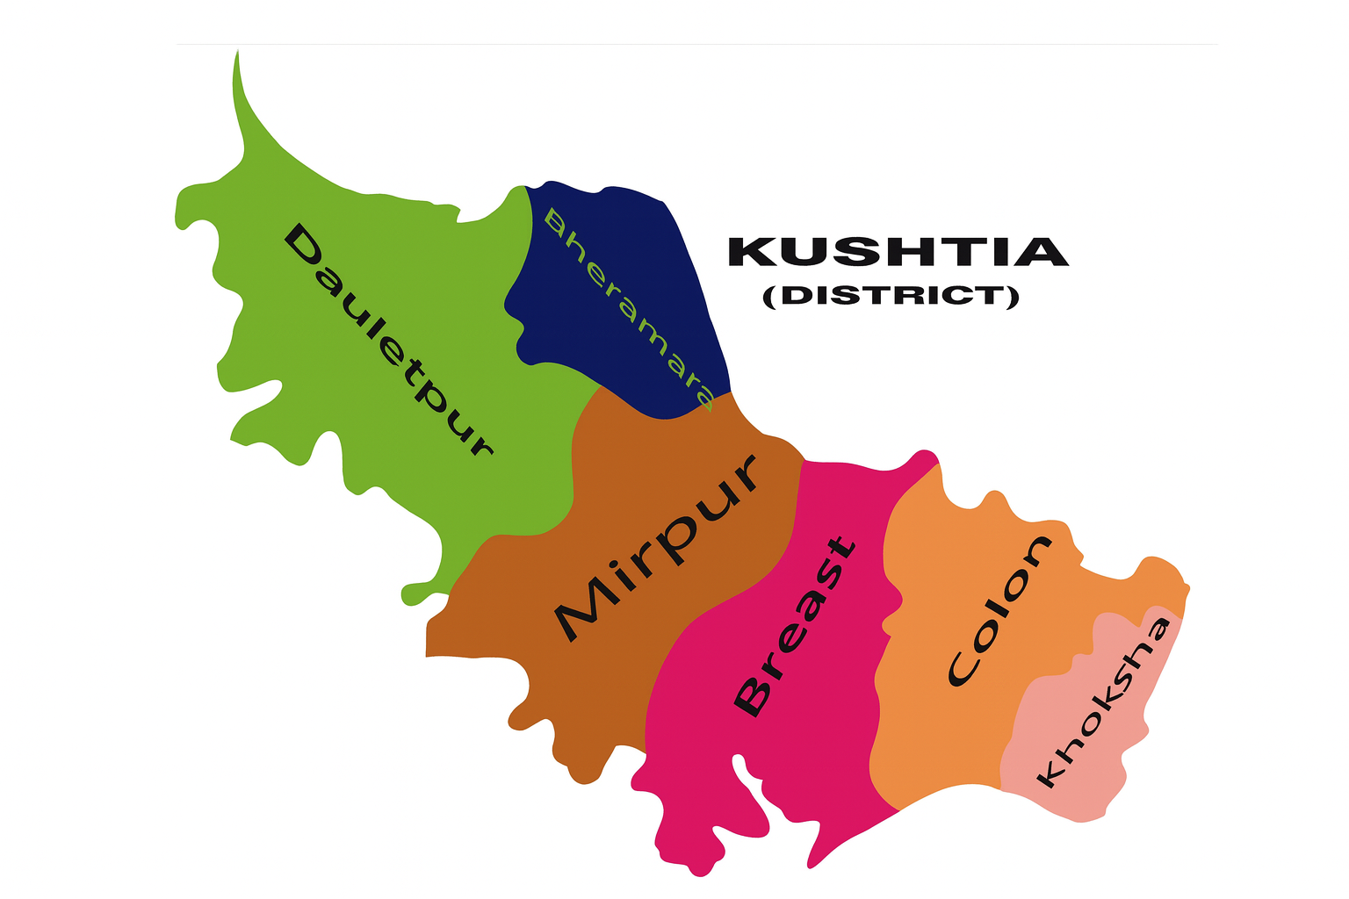
Area wise distribution
High-volume, multi-cancer cluster
  Kushtia Sadar
Single-dominant cancer cluster
  Kumarkhali (lung carcinoma predominance)
  Khoksa (colorectal carcinoma predominance)
Breast carcinoma–predominant cluster
  Bheramara
  Mirpur
  Daulatpur
Notes:
কুষ্টিয়া কৃষি সম্প্রসারণ অধিদপ্তরের তথ্য বলছে, জেলার ছয়টি উপজেলাতেই তামাক চাষ হয়। তবে সবচেয়ে বেশি চাষ হয় দৌলতপুর, ভেড়ামারা ও মিরপুর উপজেলায়

Slide 13
Conclusions
First district-level cancer distribution study in Bangladesh
Demonstrates feasibility of HBCR at district hospitals
Highlights need for decentralization & early detection
Supports strengthening district-level oncology services

Slide 14
Topic to Debate:
Model Tumor board
Multidisciplinary team

